Slide 1
TORCH Conference Spring 2023
J. Brandon Durbin, CPA
101 W Renner Rd, Ste 475, Richardson Tx 75082
brandon@dhcg.com
469-361-0120 (o)
214-538-8491 (c)

Slide 2
Topics
Updates and Current Events
Reimbursement Law Changes
Low Volume Payments
Medicare DSH / 340B
CAH Mileage
Transparency
REH
Waiver Update –DSH, UC, CHIRP, RAPPS, HARP, TIPPS, QIPP.
Local Funds Monitoring & IGT Funding Issues
COVID
What’s the Future
Scan to get your copy NOW
Notes:
Scan the QR Code to get a copy of the slides via email and to make sure we’ve got current contact information for communications and updates throughout the year.
If you don’t get a copy email jamesa@dhcg.com to work with our technology team to ensure you are getting this and follow-on communications.

Slide 3
Reimbursement Update

Slide 4
Low Volume Payment Adjustment
Congress did pass a two-year extension to the Low Volume Payment adjustment in December 2022 (Section 4101 and 4102 –Consolidations Appropriations Act of 2023)
This Act extends the LVPA for the period Oct 2022 – Sept 2024
Hospitals less than 3800 total discharges
Hospitals that are more than 15 miles from nearest IPPS hospital
We appreciate TORCH’s attention and work toward the inclusion of the LVPA into the Appropriations Bill.

Slide 5
Medicare DSH and 340B
Can
Eligibility
PPS hospitals (incl rural classifications), CAH, rural referral centers (RRC), Children’s hosp, Freestanding Cancer facilities
Prospectively Paid Hospitals
Not classified as Sole Community (SCH)
Medicare Disproportionate Share (DSH) Payment percentage – 11.75% or greater from most recent CR
Sole Community (SCH)
Medicare DSH Payment percentage – 8% or greater from most recently filed CR
Trend in Pharmaceutical companies toward reducing participation for those hospitals that have multiple contracts.
Companies are encouraging only one retail outlet or indicating a primary outlet.
Notes:
Hospital 340B qualifications – Discounted pricing program on OP pharmacy
Pharmaceutical companies are looking at retail contracts and are stipulating rules and reduced participation for those hospitals that have multiple contracts – companies are wanting one primary retail contract.
For profits not eligible for 340B

Slide 6
Medicare DSH and 340B
Can
340B Program requirements
HRSA rules mandate hospital’s notification of ineligibility in 340B program upon filing of CR indicating lack of eligibility.
HRSA mandates hospital cease purchasing drugs at 340B pricing on day hospital files the CR
FAQ on HRSA website addressing amended / reopened cost reports and lack of retroactive application for 340B eligibility.
Notes:
Amended CR – wording used states that 340B pricing can resume upon filing an eligible CR and sending support to HRSA, however amended report may not be applied retroactively.

Slide 7
Modified COP for CAH Mileage Hospitals - November 2022
Revision in OP final rule adds a key statement to the Definition of a Primary Road
Pertains to the 35-mile proximity test for CAH certification
Former statute
Primary Road is any numbered Federal highway or a four-lane (two lanes each direction) roadway.
Approved revision to the rule –
Primary Road would include any numbered Federal highway or other roadway with four lanes (two or more lanes in each direction).
Similar to description for numbered state highways and excludes numbered federal highways with only one lane in each direction (or less than 4 lanes).

Slide 8
CAH Mileage
Revision adds a key statement to the Definition of a Primary Road
Pertains to the 35-mile proximity test for CAH certification
This revision impacts approx. 10 hospitals in the state of Texas
Recommendations:
Evaluate reimbursement impact and operational strategies in conversion to CAH
Conversion considerations
Average length of patient stay
Available and licensed beds
Enrollment process

Slide 9
Price Transparency
This is continuing to gain momentum
CMS / HHSC compliance and audits are starting. Have had one completed.
Press & Politics
We believe the compliance efforts by state & federal will continue to increase.
Data can be useful in negotiation of managed care contracting
Data can be harmful in politics
National Academy for State Health Policy (NASHP). https://nashp.org
Backed by insurance companies, and is showing distorted profitability data of hospitals. “Hospitals could cover all uninsured cost at Medicare rates by private insurance”
https://tool.nashp.org

Slide 10
Rural Emergency Hospital (REH)
New provider type created by Consolidated Appropriations Act (CAA) 2021
Final Rules included in 2023 OPPS Proposed Rule – issued in November 2022.
Must be Medicare enrolled CAH or rural hospital with 50 beds or less on date CAA was signed to convert to REH (December 27, 2020)
Submit change of information CMS-855A rather than initial enrollment application

Slide 11
REH cont’d.
REH must provide Emergency Department and Observation Care services; may include other outpatient services elected by the REH
No acute care inpatient services
Can provide post-hospital extended care services furnished in distinct part unit licensed as skilled nursing facility
Must have transfer agreement with Level I or Level II trauma center
Annual per patient average of 24 hours or less in the REH
Maintain quality measures and reporting as established by CMS

Slide 12
REH cont’d.
Payments for REH services begin January 1, 2023
Claims payments for billed OP services PLUS;
Monthly facility payment
Ideally, facility payment is designed to cover excess ER cost over claims processing.
Estimated Monthly REH facility payment
CY (Calendar Year) 2023 - $3.2M annually (estimated)
Or approx $270,000 per month – per OPPS 2023 Medicare rule
Payment for REH services equal to established OPPS rate for the same service plus 5%
Includes off-campus provider-based OP departments
Ambulance services will be paid under Ambulance fee schedule
SNF paid per RUG rates – no cost-based swing bed under REH
Notes:
No swing bed services for CAHs converting to REH, these are certified SNFs w RUG rates.

Slide 13
REH cont’d.
Hospital OPPS payment Example
Charges $1,300 total - $975 ER charge combined with a $325 radiology scan
Under CAH payment methodology Under REH payment methodology
ER cost / charge ratio - .974498 Total OPPS APC charges $1,300.
Radiology cost / charge ratio - 1.303713
Gross Reimb - ER visit $950. Bundled Gross OPPS Payment $ 556.
Radiology scan $423.
Total $1,373.
Less Deduct $ 274. Less Deduct / Coins $ 203.
Net Reimb $ 1,099. Net Reimb $ 353.
Total Variance between CAH and OPPS ($ 746)
Notes:
Slight amount of sequestration not reflected in above amounts.

Slide 14
REH cont’d.
A Few Things to Consider:
For all hospitals:
Volume of IP Services now and over next 10 years
Community Perspective of eliminating Inpatient Volume / Care / potentially staffing
Impact to Medicare Advantage and other Payors (incl Medicaid and Commercial)
Can provide telehealth services under REH
For CAHs:
Volume of swing bed services and difference in Cost Based vs RUG rate payment model
Difference between Outpatient Cost Based Pmts. vs OP PPS Payment model
Adding back in Hospital Facility Payment trended over time.
Notes:
Think about trending amounts, this is not a one-year decision
.

Slide 15
Is REH the solution?
Maybe….
For a very small subset of the hospitals, it’s a temporary solution.
Shrinking communities
Those that would close otherwise.
Communities will not like this, if there is another way to have care, but it is better than no care.
Other options
CHART – Well CMS killed that program for no participation (3/17/23)
This program needs to get better before it will really mean more than a temporary lifeline.

Slide 16
1115 Waiver Update

Slide 17
DSH & UC rules
New proposed rules are in draft, and will be published Friday.
The draft has significant changes. No hospital specific, but by class there is 35% increase in Rural Public for DSH. $33M in all funds.
A slight decrease in the UC of -1%. Due to the DSH offset.

Slide 18
Reporting Issues
How to keep from getting a dirty letter…
Medicaid Managed Care percentage should be 80-95% of your total Medicaid. They look at this ratio for accuracy in reporting. 94% of the Medicaid is Managed Care.
Round 2, the denominator should be 2x of the Round 1 denominator. If not, you need an explanation. They are looking for increasing compliance. This does not occur if you counted your patients in Round 1.

Slide 19
Uncompensated Care (UC) Key Dates
DY12 Final IGT - September 6, 2023 (Settlement Date)
DY13 Advance IGT - Projected February 2024
DY13 Final IGT - Projected September 2024
Notes:
Do not have estimated dates beyond DY12. Is UC approved beyond DY12?

Slide 20
UC Issues
Data is still the key to all these waiver programs.
We have seen hospitals harmed by poor data availability.
For presumptive charity, you MUST actually write these accounts off.
Several clients have the report, but have not integrated this into their revenue cycle

Slide 21
CHIRP Y2 R2 Reporting- Due April 30th
Component 1 Reporting
Health Information Exchange (HIE) Participation- NOT reported this round.
Learning Collaborative Participation- NOT reported this round.
Medication Reconciliation: # of Unintentional Med Discrepancies per Patient (All Payer)
If implemented but have fewer than the 76 minimum interviews, submit all you have completed.
Since most facilities do not have a process, you report zero. Most rural facilities report Zero.
Component 2 Reporting- 2 Measures for Rural – Also for RAPPS
Tobacco Use: Screening & Cessation Intervention
Percentage of patients aged 18 years and older who were screened for tobacco use one or more times within 12 months AND who received tobacco cessation intervention if identified as a tobacco user
Influenza Immunization- 2 time periods to consider (Patient is counted (MET) if in EITHER time period)
Percentage of patients aged 6 months and older seen for a visit between January 1- March 31, 2022 who received an influenza immunization OR who reported previous receipt of an influenza immunization August 1, 2021- March 31, 2022.
Percentage of patients aged 6 months and older seen for a visit between October 1- December 31, 2022 who received an influenza immunization OR who reported previous receipt of an influenza immunization August 1, 2022- December 31, 2022.
Reporting measurement period for Round 2:
1/1/22 to 12/31/22 (Influenza Immunization differs)
Payer stratification for Component 2: Medicaid Managed Care, Other Medicaid, Uninsured, and All Payer
This is a struggle. They are looking for about 94% in Medicaid Managed Care vs Traditional Medicaid.
Notes:
For Round 2 reporting, you do not need to report on any structure measures, so the only measure to report for Component 1 is the Med Rec measure.
We have had a few questions about what if we started the process at a point during the measurement year, but we didn’t do the minimum number of interviews? Report on the interviews you did complete.
For Component 2, really watch the timelines for the denominator and numerator inclusions on the influenza measure.
As for payer stratification, we know that many providers are still struggling with identifying Medicaid Managed Care encounters versus Fee-for-Service Medicaid, but HHSC is going to continue to require you to report measures by this stratification.

Slide 22
CHIRP Reporting- Proposed Year 3
Component 1 Reporting
Health Information Exchange (HIE) Participation – Reporting only
Learning Collaborative Participation
Non-Medical Drivers of Health Screening (New Structure Measure; Added to All DPPs)
Status of screening for food insecurity, housing, & transportation needs.
Medication Reconciliation: # of Unintentional Med Discrepancies per Patient
Will year 4 require performance?
Component 2 Reporting- 2 Measures for Rural
Tobacco Use: Screening & Cessation Intervention
Counseling/pharmacotherapy can now occur 6 mo. prior to measurement period.
No exclusions for medical reason for not screening; only exclusion is Hospice.
Influenza Immunization (still on RAPPS)
2. Screening for Depression & Follow-up Plan (New Process Measure)
Patients aged 12 years and older screened on date of encounter (or up to 14 days prior) using an age-appropriate standardized tool, AND who received a documented follow-up plan within 2 days after the encounter if positive for depression.
Notes:
For PY3, you’ll have the same number of measure to report, but
For Component 1, the Learning Collab measure is gone and replaced with the Non-Medical Drivers of Health Screening that will be reported for all DPPs.
For Component 2, the influenza measure is gone (it is still in RAPPS). For CHIRP, it is replaced with Depression Screening & Follow-up Plan.

Slide 23
CHIRP Key Dates
April 30, 2023 - PY2, Round 2 Reporting Due to HHSC
Measurement Period January 1, 2022- December 31, 2022
Office Hours for Questions – TEAMS Meeting
April 12th, 19th, and 26th 11-11:30 a.m.
June 2, 2023 - Estimated IGT Settlement Date (PY3 1st IGT)
June 21- July 22, 2023 - PY2 Corrections Period – Round 2 reporting
Summer 2023 - PY3 Webinar by HHSC
Measures & Specification Changes
October 31, 2023 - PY3, Round 1 Reporting Due to HHSC
Measurement Period January 1, 2023- June 30, 2023
November 17, 2023 - Estimated IGT Settlement Date (PY3 2nd IGT)
Notes:
If you have questions about your CHIRP reporting, HHSC is offering time slots where you can call in and get help. The first one was this morning, but there are two more: the 19th and the 26th from 11-11:30.

Slide 24
RAPPS Y2 R2 Reporting- Due April 30th
Component 1 Reporting- NOT reported this round
Care coordination
Telemedicine/telehealth capabilities
Electronic health record (E.H.R.) use
Component 2 Reporting
A1C Poor Control (>9.0%)
Percentage of patients aged 18-75 with diabetes whose most recent hemoglobin A1C during the measurement period (January 1, 2022- December 31, 2022) was >9.0% OR do not have an A1C result recorded.
Influenza Immunization- 2 time periods to consider (Patient is MET if MET in EITHER time period)
Percentage of patients aged 6 months and older seen for a visit between January 1- March 31, 2022 who received an influenza immunization OR who reported previous receipt of an influenza immunization August 1, 2021- March 31, 2022.
Percentage of patients aged 6 months and older seen for a visit between October 1- December 31, 2022 who received an influenza immunization OR who reported previous receipt of an influenza immunization August 1, 2022- December 31, 2022.
Payer stratification: Medicaid Managed Care, Other Medicaid, Uninsured, and All Payer
Notes:
For Round 2 reporting, you do NOT need to report on any structure measures, so there is nothing to report for Component 1.
For Component 2, as with CHIRP, be sure to pay attention to the denominator and numerator time periods.

Slide 25
RAPPS Reporting- Proposed Year 3
Component 1 Reporting
Care coordination
Telemedicine/telehealth capabilities
Electronic health record (E.H.R.) use
1. Non-Medical Drivers of Health Screening (New Structure Measure; Added to All DPPs)
Status of screening for food insecurity, housing, & transportation needs
2. Health Information Exchange (HIE) Participation (New Structure Measure; Also in CHIRP)
3. Depression Screening & Follow-up Practices (New Structure Measure)
Component 2 Reporting
Controlling High Blood Pressure
Percentage of patients aged 18-85 with hypertension whose most recent blood pressure during the measurement period was <140 (systolic) and <90 (diastolic).
Influenza Immunization- 3 Big Changes
Timeline change: Percentage of patients aged 6 months and older seen for a visit between October 1, 2022- March 31, 2023 who received an influenza immunization OR who reported previous receipt of an influenza immunization July 1, 2022- June 30, 2023.
Patient attestations to receiving the immunization no longer count as MET.
Patient refusals, allergies, and vaccine not available are no longer exclusions.
Payer stratification: Medicaid Managed Care, Other Medicaid, Uninsured, and All Payer
Notes:
For Year 3, all 3 of the previous Component 1 measures are being replaced with 3 new measures: Non-Medical Drivers of Health Screening, HIE Participation, and Depression Screening & Follow-Up Practices.
This last one is different than the depression screening metric being proposed for CHIRP. That one is a process measure where you report data; this one is a structure measure, so it is a status update only.
For Component 2, A1C Poor Control will be replaced with Controlling High Blood Pressure, where you will report on the number of patients with hypertension whose most recent blood pressure was <140 systolic and <90 diastolic.
The influenza measure will still be here, BUT there are 3 significant changes. First, the time periods will be updated. Instead of having 2 distinct denominator periods and different numerator periods for each, you will have one denominator period that includes visits from the previous year, 10/1/22 through 3/31/23 of the current year, and one numerator period that looks back 7/1/22 to 6/30/23.
The second change is that patient attestations to receiving the shot somewhere else will no longer count as MET (this isn’t super clear in the measure spec, but it is found in the FAQs). Finally, patient refusals, allergies, and vaccine not available will no longer be exclusions.

Slide 26
RAPPS Key Dates
April 30, 2023 - PY2, Round 2 Reporting Due to HHSC
Measurement period January 1, 2022- December 31, 2022
Office Hours for Reporting Questions
April 12th, 19th, and 26th 10:30- 11a.m.
June 7, 2023 - Estimated IGT Settlement Date (PY3 1st IGT)
June 21- July 22, 2023 - PY2 Corrections Period
Summer 2023 - PY3 Webinar by HHSC
Measures & Specification Changes
October 2023 - PY3, Round 1 Reporting Due to HHSC
Measurement period January 1, 2023- June 30, 2023
November 30, 2023 - Estimated IGT Settlement Date (PY3 2nd IGT)
Notes:
HHSC is also offering Office Hours for RAPPS reporting. These are at different times than those for CHIRP. As with CHIRP though, the first one was this morning, but there are two more: April 19th and 26th from 10:30-11.

Slide 27
HARP
Notice the rural decline
Very few Traditional Medicaid Patient in rural
The “pain isn't worth the gain”?

Slide 28
Hospital Augmented Reimbursement Program (HARP)
SDA | # of Participating Hospitals Year 2 (FFY23) | Year 2 Total Payments | # of Participating Hospitals Year 1 (FFY22) | Year 1 Total Payments
Bexar | 2 | $ 39,045,212 | 4 | $ 54,062,659
Dallas | 2 | $ 190,683,820 | 2 | $ 200,666,811
El Paso | 1 | $ 16,848,054 | 1 | $ 30,090,566
Harris | 3 | $ 413,004,546 | 4 | $ 356,670,390
Jefferson | 0 | $ - | 2 | $ 25,331
Lubbock | 2 | $ 2,786,732 | 6 | $ 6,173,865
MRSA Central | 0 | $ - | 3 | $ 51,800
MRSA Northeast | 1 | $ 25,320 | 2 | $ 139,461
MRSA West | 11 | $ 1,987,669 | 34 | $ 5,566,901
Nueces | 1 | $ 370,972 | 4 | $ 638,298
Tarrant | 2 | $ 68,469,984 | 2 | $ 58,019,739
Total | 25 | $ 733,222,308 | 64 | $ 712,105,821
Notes:
**MAY WANT TO TAKE THIS SLIDE OUT** Do we want to discuss this?
Although the overall HARP dollars have increased slightly, they aren’t going to the smaller hospitals. The only SDA increases were to Harris and Tarrant. Many of the smaller hospitals are either dropping out or not qualifying for the dollars they did in Year 1. Year 2 has 25 participating hospitals compared to 64 in Year 1.
(Data found in HARP Modeling Files and matches data in Suggested IGT files; eligibility file is no longer posted on the HARP quality page.)

Slide 29
HARP Key Dates
May 4, 2023 - Estimated IGT Settlement Date (PY2 2nd IGT)
May 31, 2023 - Estimated Payment (PY2 2nd Payment)
January 5, 2024 - Estimated Settlement Date (PY3 1st IGT)
January 31, 2024 - Estimated Payment (PY3 1st Payment)
Notes:
Should we put exact estimated dates (i.e., May 4, 2023 IGT Settlement Date for PY2 R2)?

Slide 30
TIPPS
Very little rural participation
Mainly an urban program & a governmental teaching program.
Slides have data if you want it.

Slide 31
TIPPS Y2 R2 Reporting- Due April 30th TIPPS Reporting- Proposed Year 3
Component 1 Reporting
Proposed Change from 8 Reported Measures to 3
Influenza Immunization
Tobacco Use: Screening & Cessation Intervention
Tobacco Use and Help with Quitting Among Adolescents (Previously in Comp 2)
Component 2 Reporting
Proposed Change from 10 Reported Measures to 4
Childhood Immunization Status (Updated)
Immunization for Adolescents
Hemoglobin A1c Testing
Controlling High Blood Pressure (Updated)
Component 3 Reporting
Proposed Change from 6 Reported Measures to 5
Depression Response at Twelve Months (Updated)
Health Information Exchange (HIE) Participation
Screening for Depression & Follow-up Plan (Updated)
Notes:
There are some major changes proposed for TIPPS Year 3:
Component 1 is slated to go from reporting 8 measures to 3,
Component 2 is going from 10 measures to 4,
And Component 3 is going from 6 to 5.

Slide 32
TIPPS Key Dates
April 30, 2023 - PY2, Round 2 Reporting Due to HHSC
Measurement period January 1, 2022- December 31, 2022
Office Hours for Reporting Questions
April 13th, 20th, and 27th 10-10:30 a.m.
June 5, 2023 - Estimated IGT Settlement Date (PY3 1st IGT)
June 21- July 22, 2023 - PY2 Corrections Period
Summer 2023 - PY3 Webinar by HHSC
Measures & Specification Changes
October 31, 2023 - PY3, Round 1 Reporting Due to HHSC
Measurement period January 1, 2023- June 30, 2023
November 21, 2023 - Estimated IGT Settlement Date (PY3 2nd IGT)
Notes:
The reporting help Office Hours will be tomorrow from 10-10:30 and April 20th & 27th from 10-10:30.

Slide 33
DPP Contact Information
Sign-up for Notifications –
https://service.govdelivery.com/accounts/TXHHSC/subscriber/new
Measure Specification & Performance Requirement Questions –
DPPQuality@hhs.texas.gov
Financial, Eligibility, and IGT Questions –
CHIRP, RAPPS, HARP PFD_Hospitals@hhsc.state.tx.us
TIPPS PFD_TIPPS@hhs.texas.gov
DPP BHS PFD_DPPBHS@hhs.texas.gov
LoFTS Questions –
PFD_LFM@hhs.texas.gov

Slide 34
Do we miss our Anchor calls?
We think, based on the feedback from our clients that we need to have these types of calls periodically.
CHIRP and other applications
Reporting questions
A rural friendly call, not dominated by the major health systems.
Two ideas
A cloud depository of all the HHSC materials, even those that are outdated
Hosting a “Anchor” type call, by region or other… Me may not know the answer, but at least we will try and find it. And its free…
If you are interested in these types of calls, please email
Sherri Powell – sherrip@dhcg.com

Slide 35
QIPP Update Year 5 Concerns
Component 1 Allocation / Reconciliation
This is out last week.
Several payables and receivables, by each MCO.
May affect future payments
The IGT refund is a couple months past due from HHSC.
Performance Improvement Plan (PIP) has removed some providers. This will continue to grow in the future to tie into pay for performance guidelines.

Slide 36
Local Funds Monitoring (LoFTS)
Four phases/modules of initial reporting (only GEs report; no private providers):
Module 1- LPPFs
Module 2- Hospital programs outside of LPPF
DSH, UC, CHIRP, DSRIP, NAIP, HARP
Module 3- Non-hospital programs outside of LPPF
Due April 30, 2023 at 11:59 p.m.
RAPPS, QIPP, TIPPS, DPP-BHS, ICF-UPL, UC Dental/UC Physician, NAIP, DSRIP
If all DSRIP IGT was reported in Module 2, you do NOT have to report DSRIP again here.
Corrections posted 4/5/23 to the LoFTS page regarding reporting eligibility.
Module 4- Ambulance & school-based services
Yearly reporting each October moving forward
In-depth reviews
114 of 163 Module 2 providers were selected, based on a risk assessment score. (Black Box).
Budget(s), board minutes approving budget(s) for the FFY22
Details on “Other Income”
Bank statements showing ad valorem taxes going in and IGT going out for FFY22
Notes:
There are four initial phase of reporting for Government Entities for FFY22, October 1, 2021 through September 30, 2022. Private providers do NOT have to report.
Module 1 was only completed by GEs that oversees LPPFs.
Module 2 was completed for all GEs that IGT for hospitals, outside of an LPPF. This included IGT for DSH, UC, CHIRP, DSRIP, NAIP, and HARP.
Module 3 is due April 30th at 11:59 p.m. There was a mistake in the initial list of providers who were required to report-- UC providers were listed as now having to report for UC-Physician. This was corrected on April 5th. If you are not doing UC-Physician (only 13 participants in UC-Physician in Texas), you do NOT need to submit for UC.
Also, if you already submitted IGT information on DSRIP in Round 2, you do NOT have to do it again here; you do not have to break out how much was for hospital programs and how much was for non-hospital programs.
Module 4 will be for ambulance and school-based services.
Moving forward, reporting will be required every October.
In-depth reviews will continue. For this last round that was due today at noon, 114 out of 163 Module 2 providers were selected for review. The LoFTS team has said that was based on a risk assessment score– May want to leave this out.
Providers were required to submit their budget for FFY22 (and had to submit more than one budget if their FY didn’t cover all the months requested). They also had to submit board minutes showing the approval of that budget, details on “Other Income” if that was selected as an area of income on Module 2’s reporting, and bank statements showing all ad valorem taxes going in and IGT going out for FFY22.

Slide 37
LoFTS
The items requested are based on the latest CMS – OIG review of Parkland.
Parkland OIG asks for $400M in return.
Based on Tax Revenue
Parkland did not isolate other dollars
Parkland could not identify how patient revenue was eligible or how the dollars were identified.
Dollars do not have names attached to them….
Backdoor MFAR regulations
Texas has sued CMS in the EDTX.

Slide 38
The State of IGT
The monitoring is going to have consequences
Parkland case is an example
They do not want to allow patient revenue
They are asking for unavailable/unattainable isolation of IGT funds
Risk areas
Small public / private relationships with rent
QIPP rely on patient revenue.
IGT’s in excess of tax revenue.
LPPF’s
Recent CMS memo prohibits private to private arrangements
Lawsuit in EDTX – A win may not matter long term.
LPPF advantage over public IGT, is that the Tax is a “cost” and they get partially reimbursed for their cost of IGT.

Slide 39
MJ-LPPF
Multi Jurisdictional LPPF’s are already in law – H&S Code 300A.
Slight tweaks in the legislation of 300B (State-wide regular LPPF) and 300A was proposed to allow more flexibility, but due to the EDTX case this is now out of the bill.
LPPF’s generally require multi hospitals in their jurisdiction
MJ LPPF allows multiple jurisdiction with only 1 hospital
Can have public hospitals, unlike the other LPPF which is private only.

Slide 40
MJ-LPPF
Multi counties, cities or districts where only one hospital is in the defined area, join and form a board to jointly assess a tax rate
The LPPF Hold Harmless EDTx case will apply
Through a CO-OP, other programs could help alleviate the issues.
Max tax is 6% of net revenue of the hospital cost report, however that is defined.
Only a hospital can participate. Districts with out a hospital or non-hospital based entities cannot.

Slide 41
COVID

Slide 42
Rural Healthcare Relief Grant What you need to know
Tier 2 (Competitive Award) was issued in November $100k - $999k per hospital
You have 9 months to spend these funds and a survey from HHSC will be issued in August for you to describe how these funds were utilized by the below categories (be sure you are not overlapping with PRF/ARP funds):
Infrastructure
Personnel
PPE
Lost Revenue

Slide 43
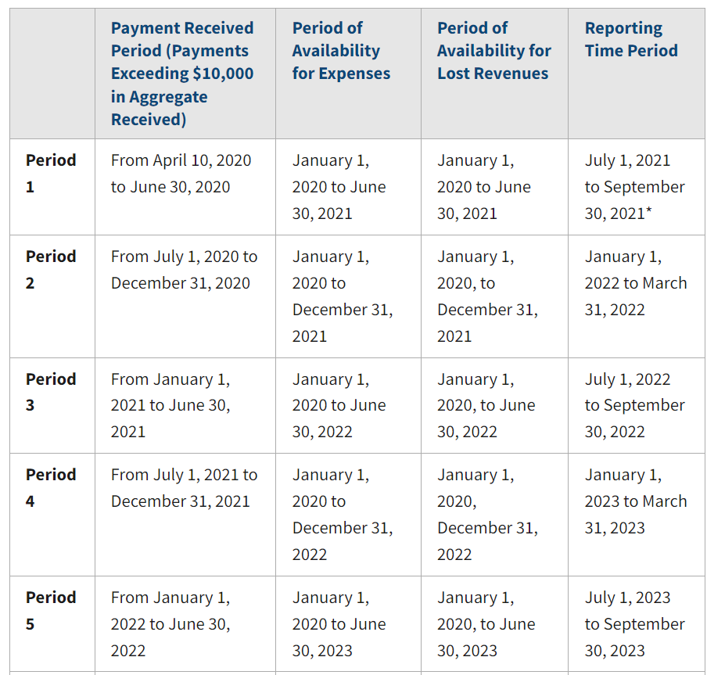
PRF/ARP Important Dates
Notes:
Information on Request to Report Late due to Extenuating Circumstances for Reporting Period 4 will be available on or around April 11th.

Slide 44
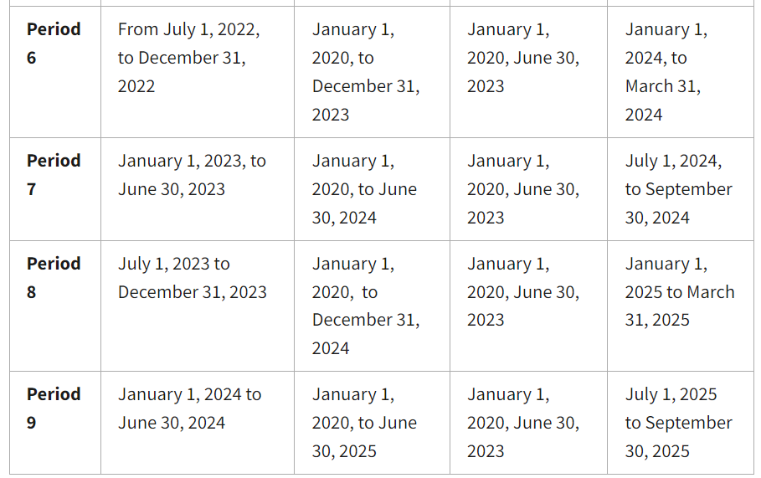
PRF/ARP Important Dates cont’d.
Notes:
Public Health Emergency ends May 11, 2023. No more funds to be released….or will there be? Still processing phase 4 PRF payments from December 16, 2021……99% of providers have been paid out to date.

Slide 45
What’s the future?

Slide 46
Waiver Programs
TNIP – Texas Network Improvement Program
Non budget neutral program. 5% of total Medicaid MCO spend.
A pilot is working on this for MRSA West
Will have a set aside for rural
Is based on MCO Medicaid revenue. Funding follows the patient.
Rural hospitals will need to engage in metric reporting to qualify.
A Rural TNIP could be developed, with a better focus for rural
CHIRP/TNIP – Rural needs to engage for more funding share and funding of access.

Slide 47
Threats!
Medicaid Advantage is growing – decreasing rural payments
Managed care contracting in general. No scale!
Medicaid waiver payments have been reduced
UPL 4Private UPL 4DSRIP 4QIPP 4UC 4CHIRP 4?
COVID was a boom…. But the funds & volume are almost gone, but the cost are still here.
Staffing cost is seeming to level, but other cost increases are permanent
So…., What’s the next thing…
What if there is not a “thing”

Slide 48
Innovation (CMS style)
P4P – Pays for paper….. Lots of reporting? Does it move the needle?
ACO’s – Who actually makes the money? They want your volume and participation, but who gets paid?
CHART – Cancelled
BPCI – Very low participation. JAMA study states it cost money…
There are NO rural hospitals inside the Washington Beltway

Slide 49
We need a new message
We get lots of “fixes” and new ideas, but what we need is a long-term sustainable competitive fairness / rates.
The problem is that rural encompasses such a broad range of sizes. Its not a one size fits all solution.
Rural needs some protection form Advantage. Not just higher payments, but something to encourage the insurance company.
If we get higher rates, then we are the “high cost provider” and they will steer care away.
The CAH copayment needs a solution, as CAH is disadvantaged.
Managed care in general ignores rural. Take it or leave it contracts, and some just don’t care.

Slide 50
When a loss is a gain
There is always two sides to the coin.
Example - The new HHA payment system is causing closure of many small agencies. The public (SEC) companies believe that’s good for business as they are more efficient and can have more patients.
You can’t beat efficiency.
Size matters in contracting and in all negotiations.

Slide 51
Only two ways to go
We can either increase revenue
We can’t invent more patients, unless you’re the Wuhon lab.
Programs that are seen as abusive by CMS for over utilization or over referrals are short lived and dangerous. Lab & Pharma.
If its not good for patient care – steer away!
You can reclaim market share – tough competition.
Or decrease expenses
HCA is example of extreme efficiency
Even combinations of 2 or 3 facilities can create remarkable economies of scale
Preferred, Mid Coast are examples where the size produces savings. Cost reports show it!

Slide 52
Efficiency & Co-Op programs
Lots of possibilities
Coop individual services continuum … Full integration of programs
Strategic partnerships of rural hospitals
Purchasing coop experience – We formed one for ourselves
Payroll & Benefits
All Insurance
40 companies in the same accounting.
Consolidated phone and internet contracting
Various IT projects, cloud storage, BI software, etc.
15 providers in the same HIM system, with a consolidated billing office
Gains are all shared.

Slide 53
Issues
Ensure the majority of the savings / profits do not go to the sponsors, consultants, or agents.
Understand past relationships may change.
Hire quality – not friends
Consider gainsharing with the leadership or sponsor
Prefer employed leadership vs. vendor sponsor
Forces new relationships and its based on business terms, not personal terms
Business experience is better than healthcare experience. We need fresh ideas!
You need a non affiliated / non biased leader
Use a not for profit corporation for the organizational structure

Slide 54
Co-OP programs
The Multi jurisdictional LPPF is a Co-OP IGT program
IT and HIM cost have already forced providers into Co-OP arrangements
Cerner / Epic
Why do we need individual IT systems?
Purchasing has been a GPO for years – but who gets the rebate… the consolidator
Name a cost –
Low lift - Insurance, Benefits, Utilities, Phone, IT support
Patient care is more complicated
Risk vs. non risk
Look at every vendor in the room – what can fit?

Slide 55
Questions?

